Slide 1


Event-Driven architecture. Apache Kafka
Kyz-Zhibek Kakimzhanova,
Software Engineer
Notes:
Just into on why we’re here today and what’s the point of having this presentation. Brifely touch the topic of presenters: SZ, OZ, IL, and KK.
In the end: passing the floot to Sviatlana.

Slide 2



I assume that you are familiar with

Slide 3
Plan
What is Kafka
What is Event Driven Architecture and it’s pros and cons
Kafka components
Topics
Partitions
Consumer groups
Offsets
Demo
Replication: leader and in-sync replicas
Delivery guaranty

Slide 4

Apache Kafka
Apache Kafka is an open-source distributed event streaming platform that was initially created for data streaming, but currently is used in various cases including microservices communication.
CAPABILITIES
HIGH THROUGHPUT
DISTRIBUTED
FAULT-TOLERANT
SCALABLE
PERMANENT STORAGE
HIGH AVAILABILITY

Slide 5
The problem
Service 1
0
Service A
Service 2
1
Service B
Service 3
2
Service C

Slide 6
Service 1
0
Service A
Service 2
Broker
Service B
1
Service 3
2
Service C

Slide 7
Event-Driven Architecture or EDA
Event-driven architecture (EDA) is a software design pattern
The communication between services is maintained using events
Event is any change of state: purchase for example. The service that produces events is a producer
The application that consumes events is a consumer. When consumer detects an event it performs some action in response to it
Both producers and consumers are unaware of each other and communicate only with the broker.
Events (messages) get published and consumed asynchronously.
Producer
Broker
Consumer

Slide 8
Advantages and disadvantages
+ | -
Loose coupling | Increasing complexity
Non-blocking | Debugging and troubleshooting challenges
Simple to scale
Resilient | Delivery guarantee is challenging

Slide 9
When to use EDA:
Critical Decision Making: Real-time situational awareness and responsiveness is important for better decision-making in critical situations, like stopping a faulty production line in manufacturing or reducing time to treatment to improve patient outcomes in healthcare systems.
Operational Efficiency: Parallel processing where multiple processes need to execute asynchronously off a triggered event.
Innovation: Agility to add new functionality without impacting existing interfaces gives the flexibility to innovate rapidly.
Integration of heterogeneous environments: A network of event brokers (event mesh) can be used to dynamically route events from a variety of locations (on premises, cloud, IoT) across connected applications and devices.

Slide 10
Apache Kafka components
Broker
Zookeeper
Producer
Consumer
Topic
Partition
Offset
--bootstrap-server=kafka:9092
Zookeeper
--topic topic.name
Messages type
publish
subscribe
Producer
Broker
Consumer

Slide 11
Topic
One topic per message type
Brocker
Broker
Producer 1
Consumer 1
Topic 1
Producer 2
Topic 2
Consumer 2
Producer 3
Topic 3
Consumer 3

Slide 12
Topic
Several consumers and producers can write/read to the same topic
Brocker
Broker
Producer 1
0
Consumer 1
Topic 1
Producer 2
1
Topic 2
Consumer 2
Producer 3
2
Consumer 3

Slide 13
Brocker
Broker
Producer 1
Serialized
Consumer 1
Topic 1
0
Producer 2
1
Topic 2
Consumer 2
Producer 3
2
Consumer 3

Slide 14
Brocker
Broker
Producer 1
Serialized
Consumer 1
Topic 1
0
Producer 2
Serialized
Consumer 2
Topic 2
1
Producer 3
2
Consumer 3

Slide 15
Brocker
Broker
Producer 1
Serialized
Consumer 1
Topic 1
0
Producer 2
Serialized
Consumer 2
Topic 2
2
1
Serialized
Producer 3
Consumer 3

Slide 16
Brocker
Broker
Deserialized
Producer 1
Consumer 1
Topic 1
0
0
Producer 2
Topic 2
Consumer 2
2
1
Producer 3
Consumer 3

Slide 17
Brocker
Broker
Deserialized
Producer 1
Consumer 1
Topic 1
0
0
Deserialized
Producer 2
Topic 2
Consumer 2
2
1
1
Producer 3
Deserialized
1
Consumer 3

Slide 18
Brocker
Broker
Deserialized
Producer 1
Consumer 1
Topic 1
0
0
Deserialized
Producer 2
Topic 2
Consumer 2
2
1
2
1
2
Producer 3
Deserialized
1
Consumer 3
Messages are not deleted in broker. They will remain for some time set in log.retention.hours broker config

Slide 19
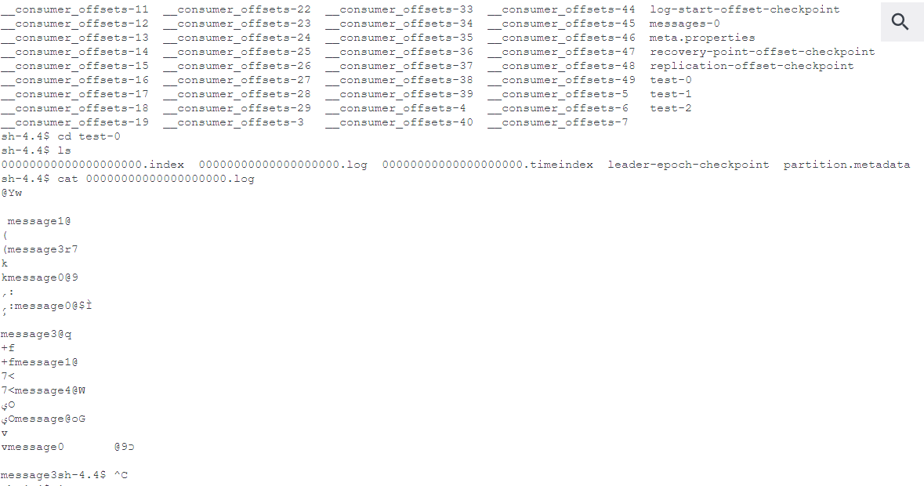
Kafka storage
Kafka messages are stored in log files by default in var/lib/kafka/data foulder

Slide 20
Kafka storage
log.retention.bytes: The maximum size of the log before deleting it
log.retention.ms The number of milliseconds to keep a log file before deleting it. If set to -1 no time limit applied. If not set log.retention.minutes
is used
log.retention.minutes retention time in minutes. If not set log.retention.hours is used
log.retention.hours: The number of hours to keep a log file before deleting it (in hours) by default 168 (7 days)
Kafka deletes log file once all the messages within have expired.

Slide 21
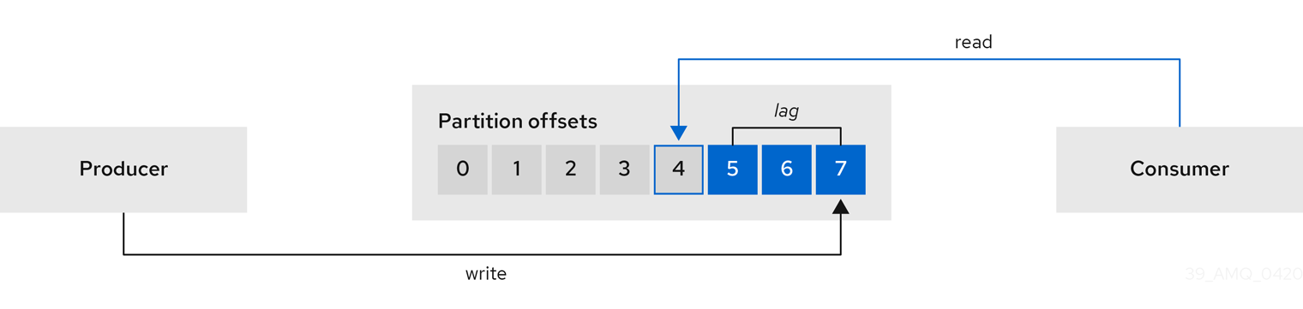
Offset
The consumer offset is a way of tracking the sequential order in which messages are received by Kafka topics.
The Kafka consumer offset allows processing to continue from where it last left off if the stream application is turned off or if there is an unexpected failure.

Slide 22
Topic partitions
Brocker
Broker
Producer 1
Consumer 1
Topic 1
Producer 2
Topic 2
Consumer 2 group.id=group1
Partition 0
Partition 1
Producer 3
Consumer 3 group.id=group1
Consumer Group

Slide 23
Brocker
Broker
Producer 1
Consumer 1
Topic 1
Producer 2
1
Topic 2
Consumer 2 group.id=group1
0
Partition 0
Partition 1
Producer 3
2
Consumer 3 group.id=group1
Consumer Group

Slide 24
Brocker
Broker
Producer 1
Consumer 1
Topic 1
Producer 2
1
Topic 2
Consumer 2 group.id=group1
0
Partition 0
Partition 1
Producer 3
2
Consumer 3 group.id=group1
Consumer Group

Slide 25
Brocker
Broker
Producer 1
Consumer 1
Topic 1
Producer 2
Topic 2
Consumer 2 group.id=group1
0
Partition 0
1
Partition 1
Producer 3
2
Consumer 3 group.id=group1
Consumer Group

Slide 26
Brocker
Broker
Producer 1
Consumer 1
Topic 1
Producer 2
Topic 2
Consumer 2 group.id=group1
2
0
Partition 0
1
Partition 1
Producer 3
Consumer 3 group.id=group1
Consumer Group

Slide 27
Brocker
Broker
Producer 1
Consumer 1
Topic 1
Producer 2
Topic 2
Consumer 2 group.id=group1
2
0
0
Partition 0
1
Partition 1
Producer 3
Consumer 3 group.id=group1
Consumer Group

Slide 28
Brocker
Broker
Producer 1
Consumer 1
Topic 1
Producer 2
Topic 2
Consumer 2 group.id=group1
2
0
0
Partition 0
1
Partition 1
Producer 3
1
Consumer 3 group.id=group1
Consumer Group

Slide 29
Order within a partition is guaranteed
Brocker
Broker
Producer 1
Consumer 1
Topic 1
Producer 2
Topic 2
Consumer 2 group.id=group1
2
0
2
0
Partition 0
1
Partition 1
Producer 3
1
Consumer 3 group.id=group1
Consumer Group

Slide 30
What if consumer is down?
Brocker
Broker
Producer 1
Consumer 1
Topic 1
Producer 2
Topic 2
Consumer 2 group.id=group1
2
0
Partition 0
1
Partition 1
Producer 3
Consumer 3 group.id=group1
Consumer Group

Slide 31
Brocker
Broker
Producer 1
Consumer 1
Topic 1
Producer 2
Topic 2
Consumer 2 group.id=group1
2
0
Partition 0
1
Partition 1
Producer 3
Consumer 3 group.id=group1
Consumer Group

Slide 32
DEMO

Slide 33
Demo kafka with docker
kafka-topics --create --topic test --bootstrap-server kafka:29092
kafka-topics --list --bootstrap-server kafka:29092
kafka-console-producer --bootstrap-server kafka:29092 --topic test
kafka-console-consumer --bootstrap-server kafka:29092 --topic test --from-beginning
kafka-topics --create --topic messages --bootstrap-server kafka:29092 --partitions 3
kafka-console-producer --bootstrap-server kafka:29092 --topic messages
kafka-console-consumer --bootstrap-server kafka:29092 --topic messages --consumer-property group.id=g1
kafka-consumer-groups --describe --group g1 --bootstrap-server kafka:9092

Slide 34
What if broker is down?
Brocker
Broker
Producer 1
Consumer 1
Topic 1
Producer 2
Topic 2
Consumer 2 group.id=group1
Partition 0
Partition 1
Producer 3
Consumer 3 group.id=group1
Consumer Group

Slide 35
Kafka Cluster
Brocker
Broker
Broker
Brocker
Producer 1
Topic 1
Consumer 1
Broker
Brocker
Topic 1
Producer 2
Topic 1
Consumer 2 group.id=group1
Topic 2
Partition 0
Topic 2
Partition 0
Partition 1
Partition 1
Topic 2
Producer 3
Partition 0
Consumer 3 group.id=group1
Partition 1
Consumer Group

Slide 36
Zookeeper
Zookeeper
Brocker
Broker
Broker
Brocker
Producer 1
Topic 1
Consumer 1
Broker
Brocker
Topic 1
Producer 2
Topic 1
Consumer 2 group.id=group1
Topic 2
Partition 0
Topic 2
Partition 0
Partition 1
Partition 1
Topic 2
Producer 3
Partition 0
Consumer 3 group.id=group1
Partition 1
Consumer Group

Slide 37
Replication
Topic2 --replication-factor 3 --partitions 2
Broker
Broker
Broker
Brocker
Brocker
Brocker
Topic 1
Topic 1
Topic 1
Topic 2
Topic 2
Topic 2
Partition 0
Partition 0
Partition 0
Partition 1
Partition 1
Partition 1
Producers and consumers only write and read from Leader partitions

Slide 38
Replication
Broker
Broker
Broker
Brocker
Brocker
Brocker
Topic 1
Topic 1
Topic 1
Topic 2
Topic 2
Topic 2
Partition 0
Partition 0
Partition 0
Partition 1
Partition 1
Partition 1
In sync partitions

Slide 39
Producer delivery guarantee
Producer setting acks
The number of acknowledgments the producer requires the leader to have received before considering a request complete. This controls the durability of records that are sent. The following settings are allowed:
At most once acks=0 If set to zero then the producer will not wait for any acknowledgment from the server at all.
At most once acks=1 This will mean the leader will write the record to its local log but will respond without awaiting full acknowledgement from all followers.
acks=all This means the leader will wait for the full set of in-sync replicas to acknowledge the record.

Slide 40
ACKS = 0
Broker
Broker
Broker
Brocker
Brocker
Brocker
Producer 1
Topic
Topic
Topic
Does not wait for acknowledgment
Partition 0
Partition 0
Partition 0
Partition 1
Partition 1
Partition 1

Slide 41
ACKS = 0
Error
Broker
Broker
Broker
Brocker
Brocker
Brocker
Producer 1
Topic
Topic
Topic
Message lost
Partition 0
Partition 0
Partition 0
Partition 1
Partition 1
Partition 1

Slide 42
ACKS = 1
Broker
Broker
Broker
Brocker
Brocker
Brocker
Producer 1
Topic
Topic
Topic
Partition 0
Partition 0
Partition 0
Partition 1
Partition 1
Partition 1

Slide 43
ACKS = 1
Broker
Broker
Broker
Brocker
Brocker
Brocker
Producer 1
Topic
Topic
Topic
Wait for acknowledgment from leader partition
Partition 0
Partition 0
Partition 0
Partition 1
Partition 1
Partition 1

Slide 44
ACKS = 1
Broker
Broker
Broker
Brocker
Brocker
Brocker
Producer 1
Topic
Topic
Topic
Message lost
Partition 0
Partition 0
Partition 0
Partition 1
Partition 1
Partition 1

Slide 45
ACKS = ALL (-1)
Broker
Broker
Broker
Brocker
Brocker
Brocker
Producer 1
Topic
Topic
Topic
Wait for acknowledgment from all in-sync partitions
Partition 0
Partition 0
Partition 0
Partition 1
Partition 1
Partition 1

Slide 46
ACKS = ALL
Broker
Broker
Broker
Brocker
Brocker
Brocker
Producer 1
Topic
Topic
Topic
Wait for acknowledgment from all in-sync partitions
Partition 0
Partition 0
Partition 0
Partition 1
Partition 1
Partition 1

Slide 47
ACKS = ALL
Broker
Broker
Broker
Brocker
Brocker
Brocker
Producer 1
Topic
Topic
Topic
Wait for acknowledgment from all in-sync partitions
Partition 0
Partition 0
Partition 0
Partition 1
Partition 1
Partition 1

Slide 48
ACKS = ALL
Broker
Broker
Broker
Brocker
Brocker
Brocker
Producer 1
Topic
Topic
Topic
Wait for acknowledgment from all in-sync partitions
Partition 0
Partition 0
Partition 0
Partition 1
Partition 1
Partition 1

Slide 49
ACKS = ALL
Broker
Broker
Broker
Brocker
Brocker
Brocker
Producer 1
Topic
Topic
Topic
Might send message again, while waiting, causing duplicates
Partition 0
Partition 0
Partition 0
Partition 1
Partition 1
Partition 1
For exactly once delivery enable.idempotence=true idempotent producer that will not duplicate messages. Exactly once delivery. Idempotence on the consumer side is not provided.

Slide 50
ACKS = ALL
Broker
Broker
Broker
Brocker
Brocker
Brocker
Producer 1
Topic
Topic
Topic
If all replicas are in-sync replicas
Partition 0
Partition 0
Partition 0
Partition 1
Partition 1
Partition 1

Slide 51
ACKS = ALL
Broker
Broker
Broker
Brocker
Brocker
Brocker
Producer 1
Topic
Topic
Topic
If all replicas are in-sync replicas
Partition 0
Partition 0
Partition 0
In sync replicas number should be less than replicas
Partition 1
Partition 1
Partition 1
Message will not be sent

Slide 52
Q&A

